Slide 1
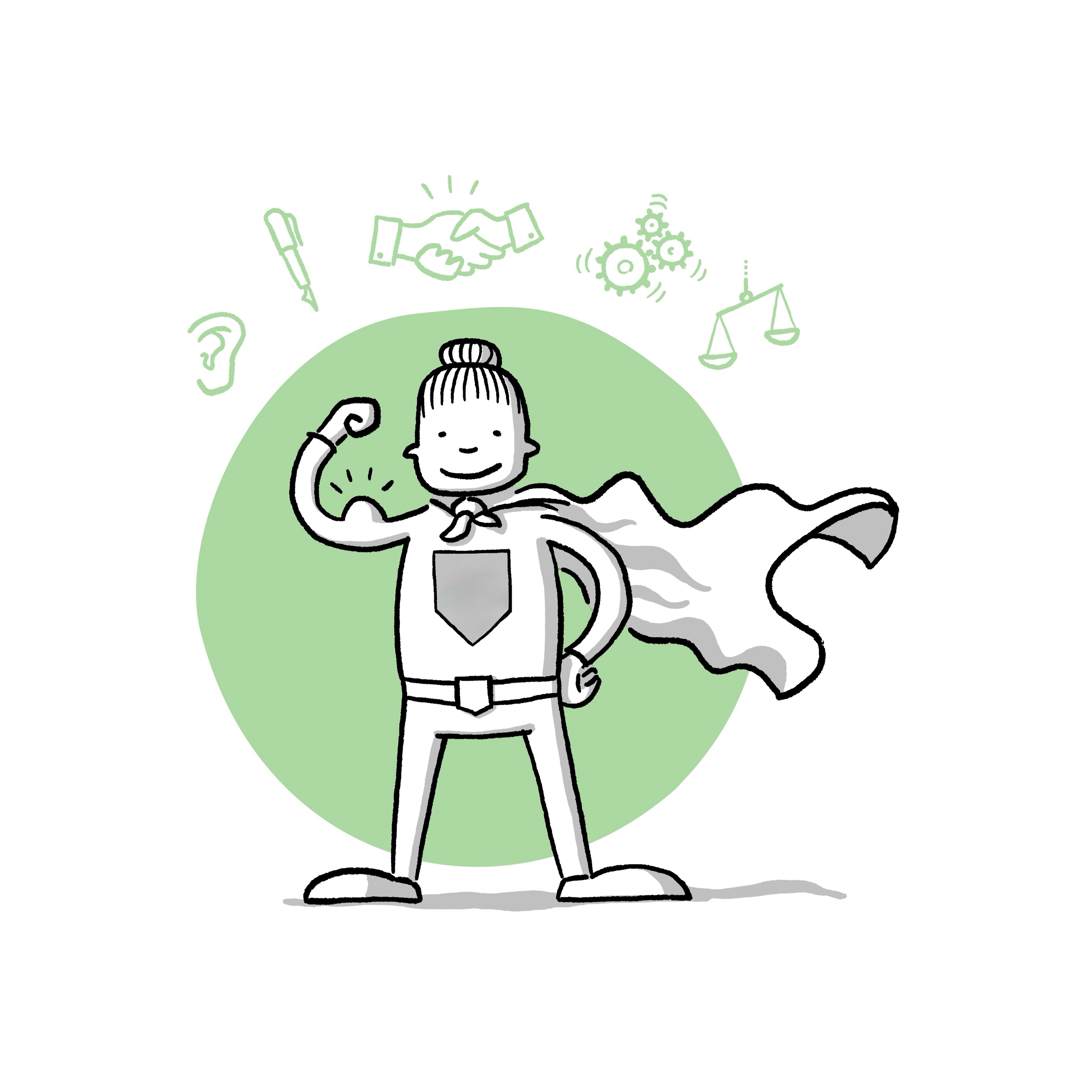
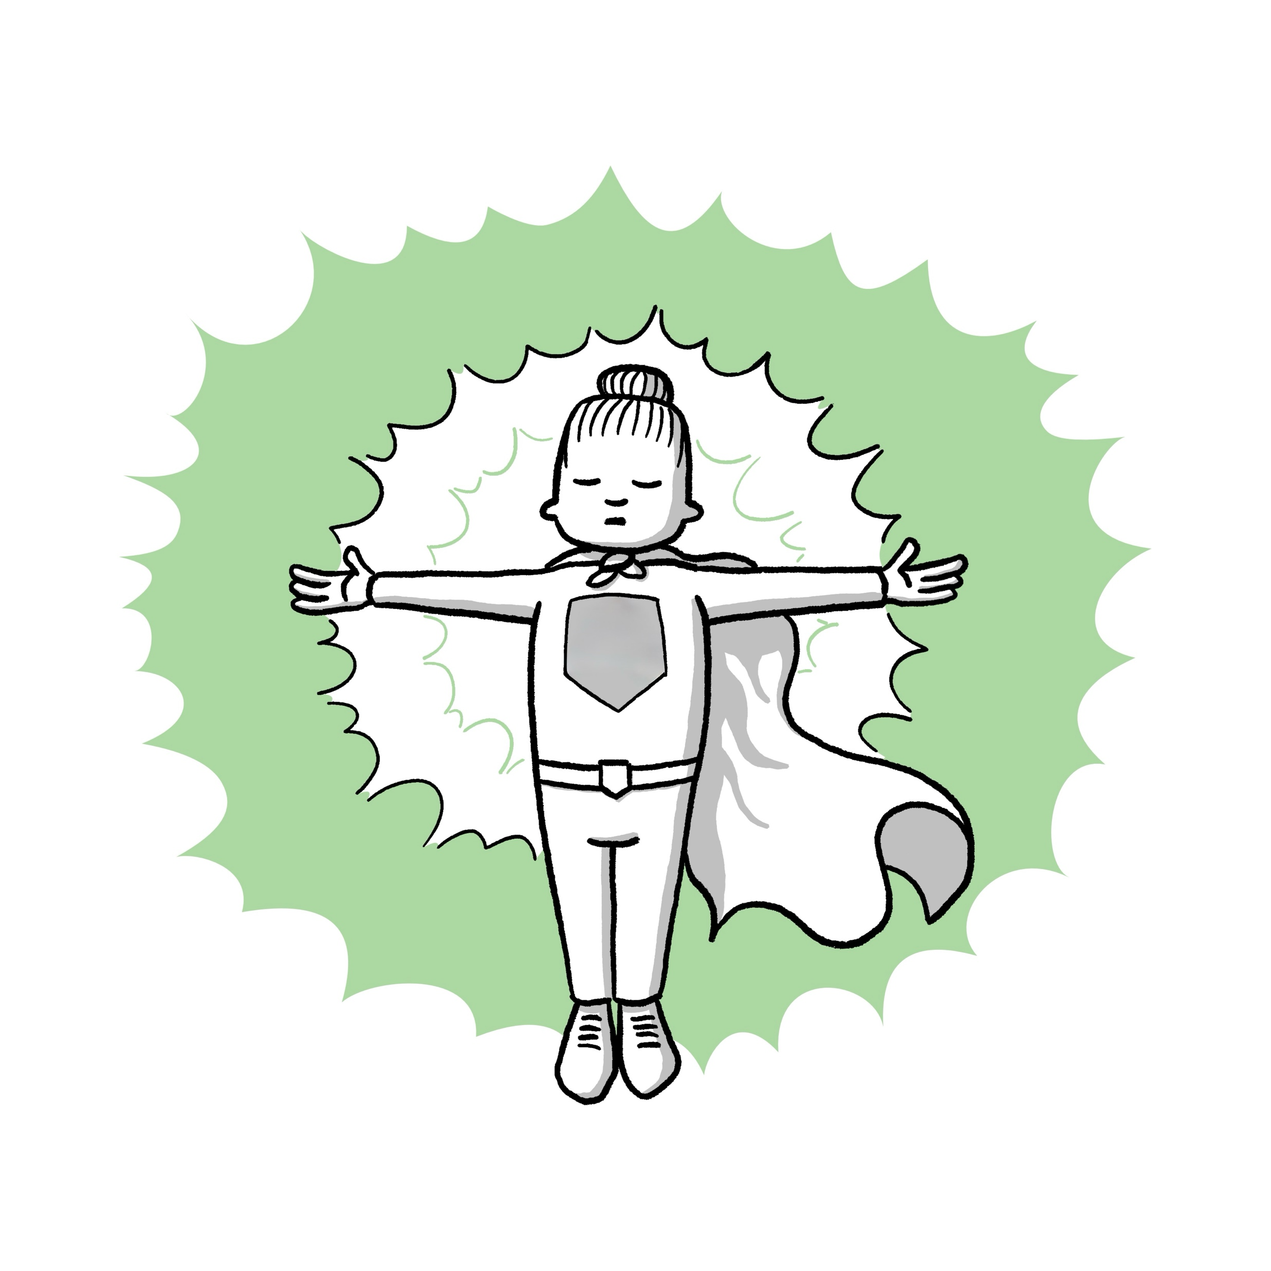
A warm welcome to today's workshop!
My boundaries = My strengths

Slide 2
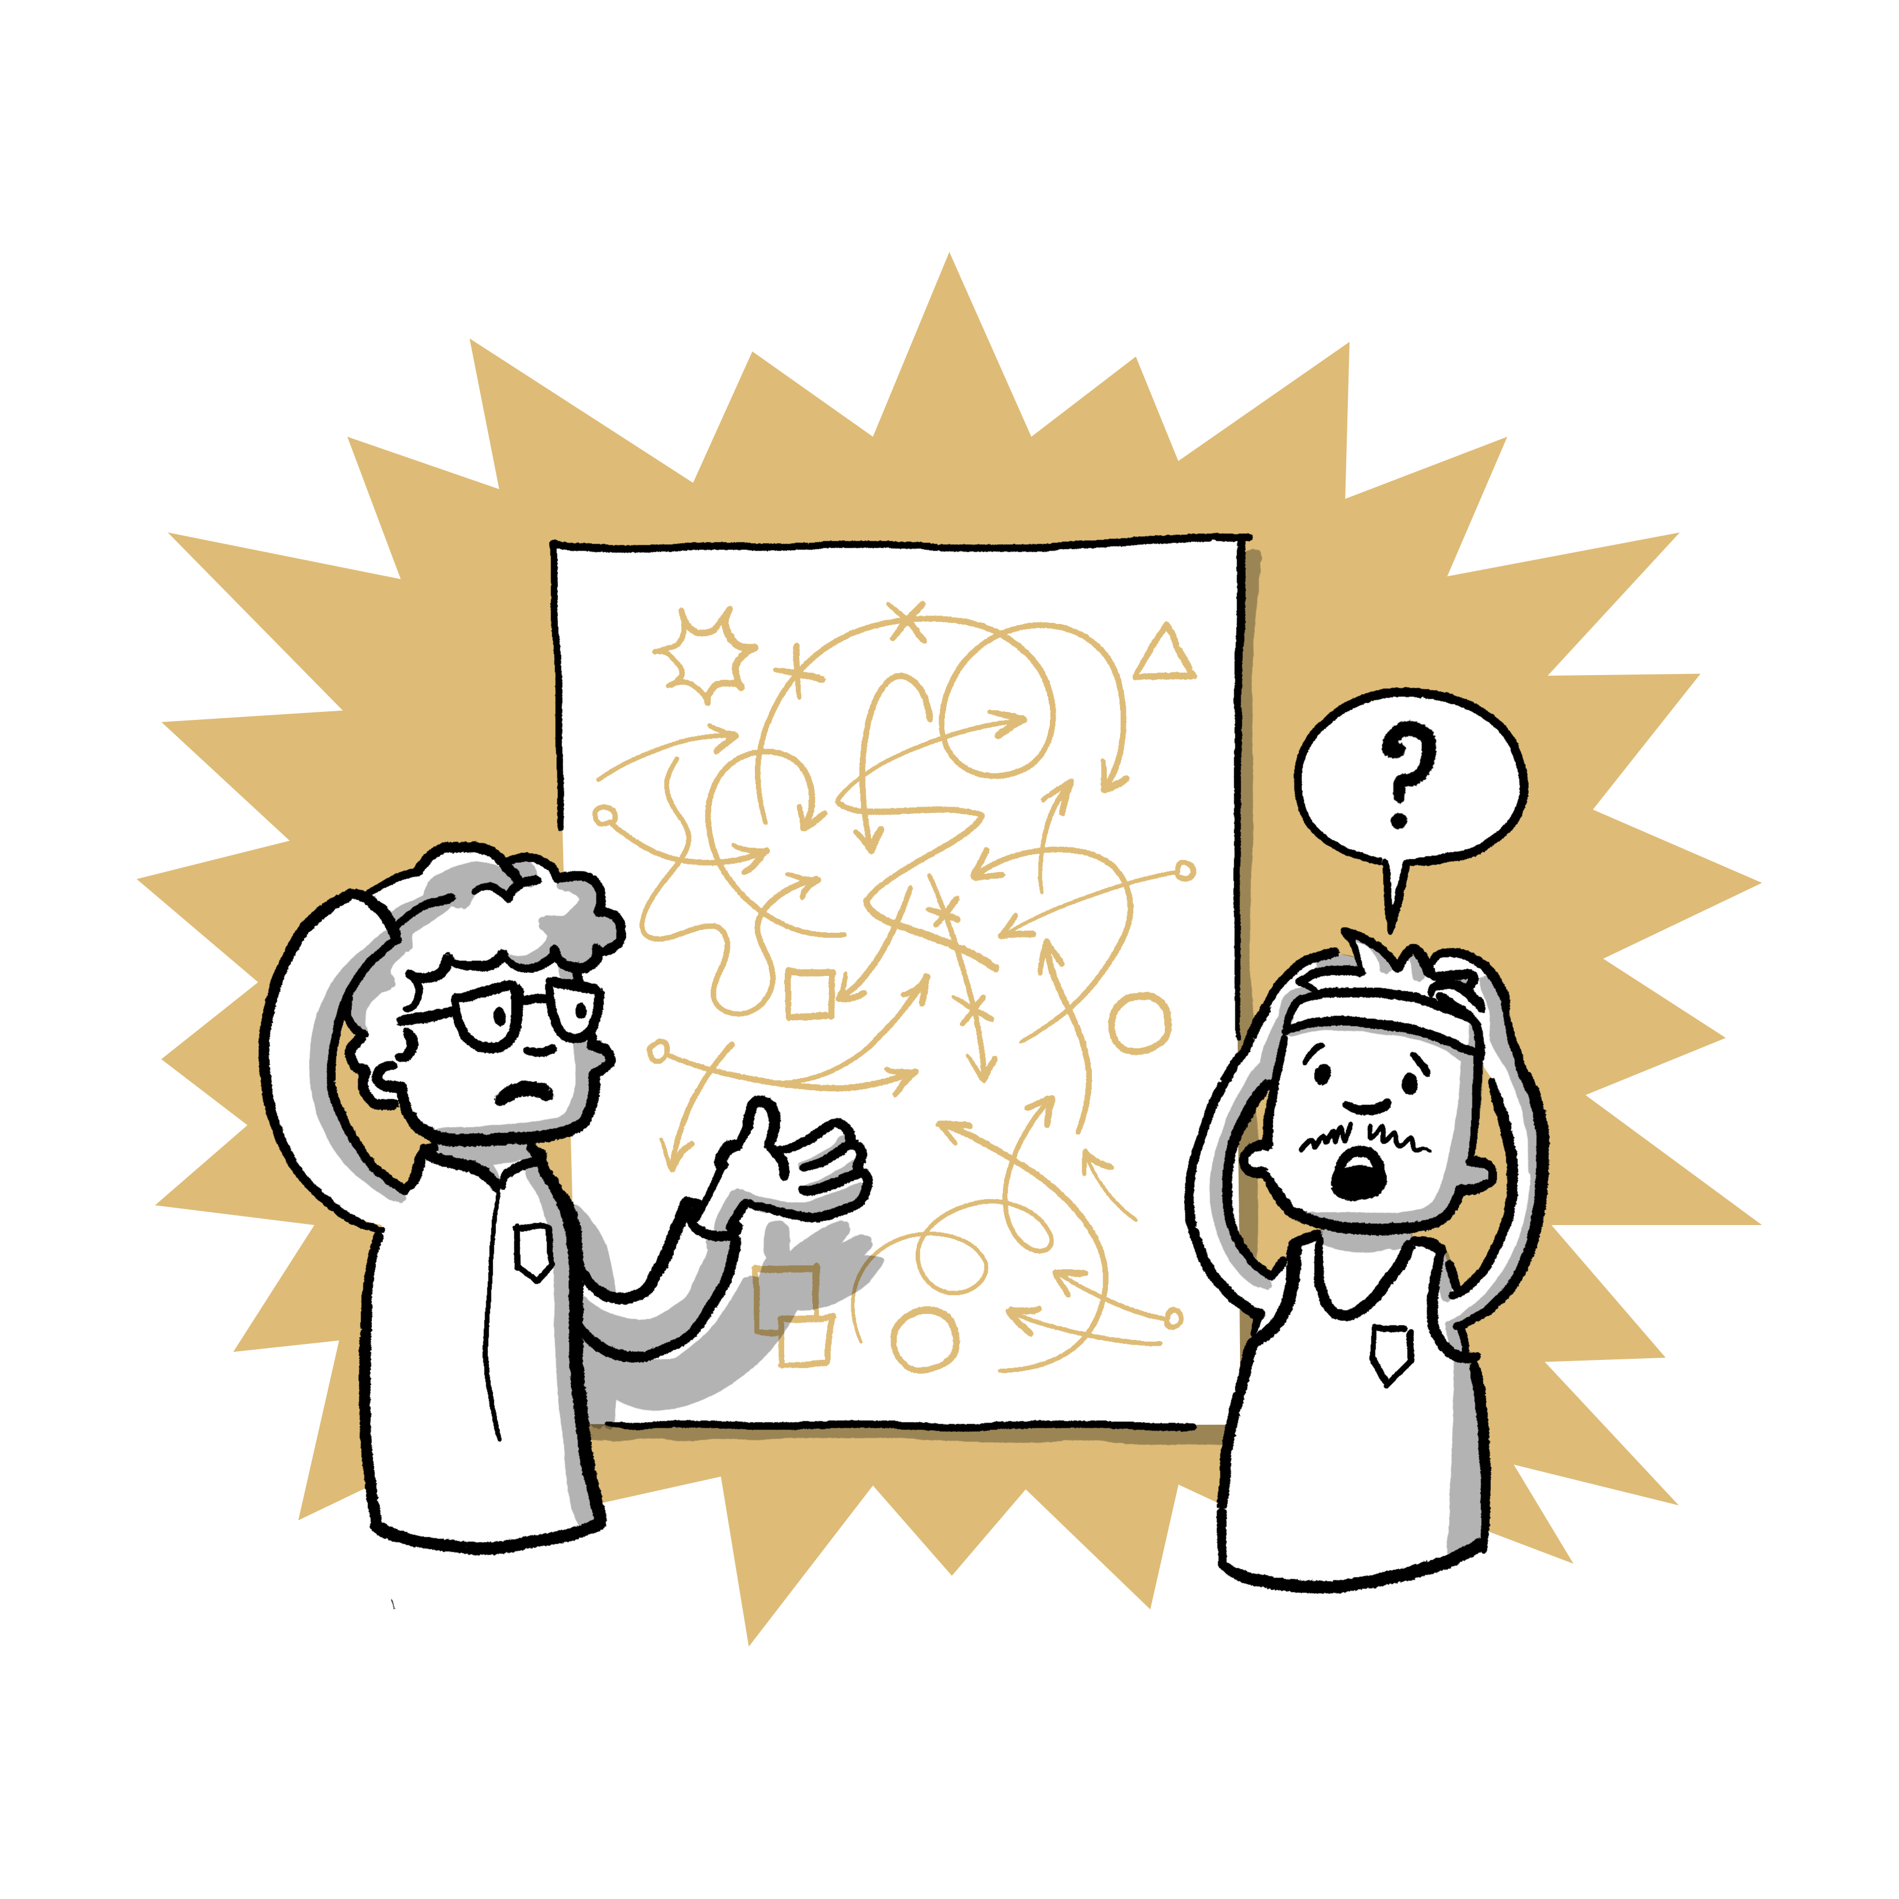
Crossing boundaries
= Violence in sport!

Slide 3
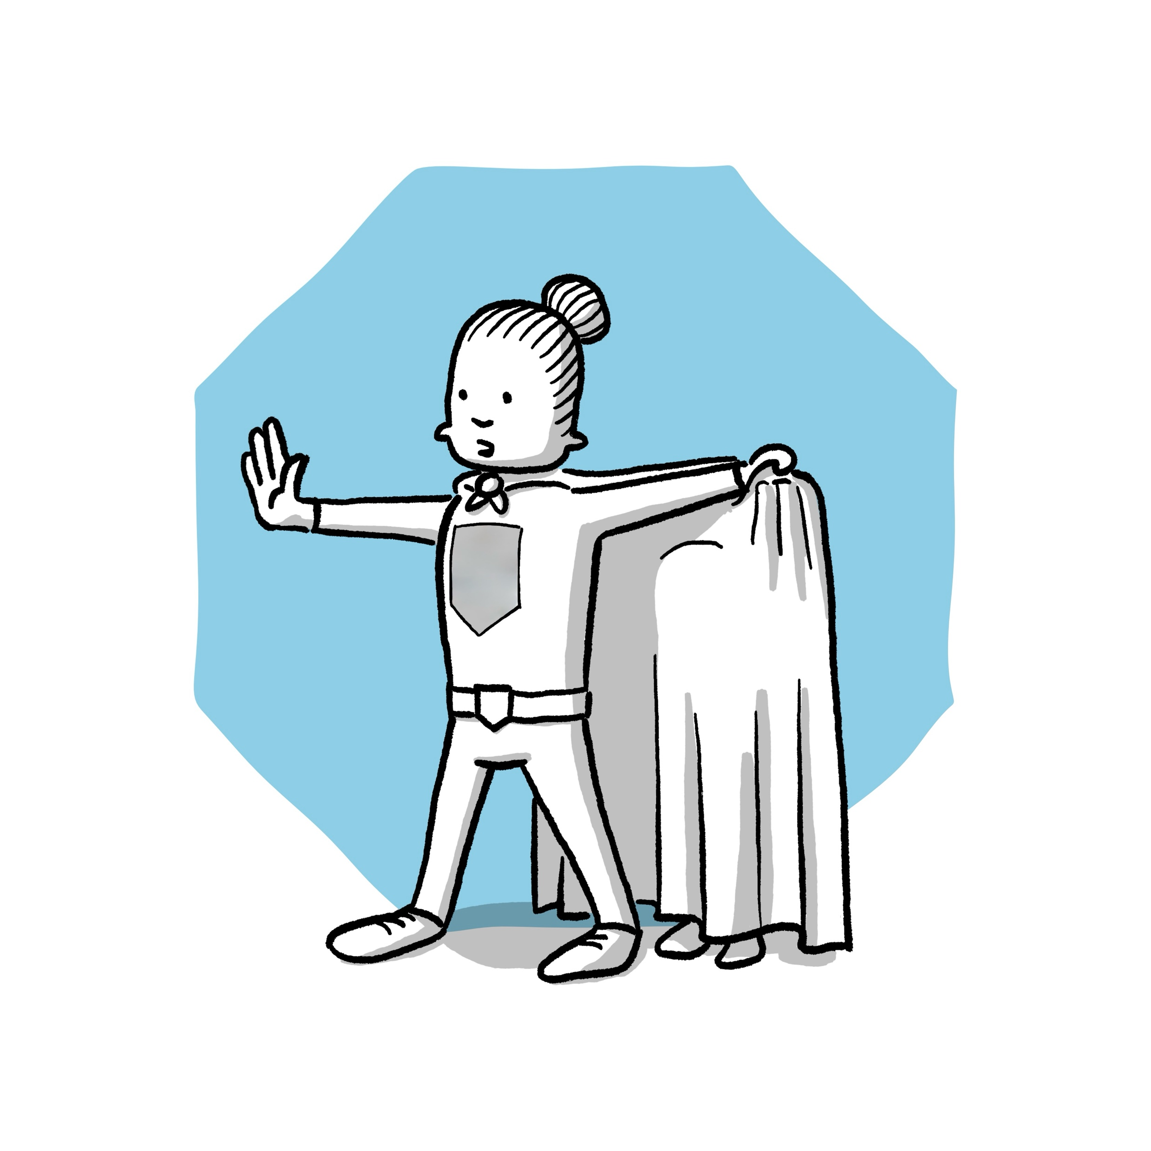
Crossing boundaries
= Violence in sport!
... Psychological violence
... Physical violence
... Sexual violence

Slide 4
Crossing boundaries
= Violence in sport!
How many athletes are affected by violence in sport?
Who perpetrates violence in sport?

Slide 5

Who can I contact?
Contact persons in the club
Name local contact points/cooperation partners
Name contact points of the association/state sports association or similar

